Slide 2
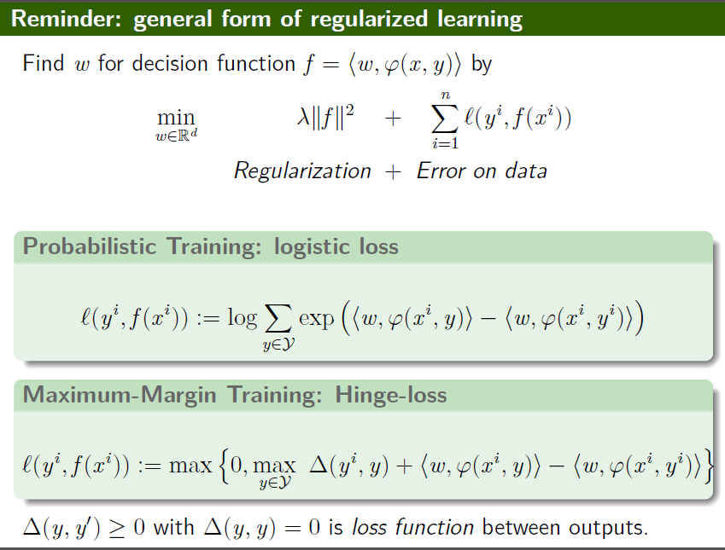

Slide 3
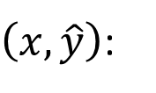


HMM - Drawbacks
Inference:
To obtain correct results …
$$\tilde{y}=arg\max_{y∈𝕐}{F\left(x,y\right)}$$
$\left(x,\hat{y}\right)$:
$$P\left(x,\hat{y}\right)>P\left(x,y\right)$$
Can HMM guarantee that?
not necessarily small
x_{i}=a
x_{i}=c
Transition probability:
1/2
1/2
……
9/10
y_{i}=V
P(V|N)=9/10
P(D|N)=1/10
Emission probability:
y_{i-1}=N
x_{i}=a
……
P(a|V)=1/2
P(a|D)=1
1
1/10
y_{i}=D

Slide 4
HMM - Drawbacks
Inference:
To obtain correct results …
$$\tilde{y}=arg\max_{y∈𝕐}{F\left(x,y\right)}$$
$\left(x,\hat{y}\right)$:
$$P\left(x,\hat{y}\right)>P\left(x,y\right)$$
Can HMM guarantee that?
not necessarily small
Transition probability:
x_{i}=a
P(V|N)=9/10
P(D|N)=1/10
……
P(x_{i}|y_{i})
Emission probability:
y_{i-1}=N
y_{i}=?
……
V
P(a|V)=1/2
P(a|D)=1
P(y_{i}|y_{i-1})

Slide 5
HMM - Drawbacks
x_{i}=a
P(x_{i}|y_{i})
y_{i-1}=N
y_{i}=?
V
D
P(y_{i}|y_{i-1})
Inference:
To obtain correct results …
$$\tilde{y}=arg\max_{y∈𝕐}{F\left(x,y\right)}$$
$\left(x,\hat{y}\right)$:
$$P\left(x,\hat{y}\right)>P\left(x,y\right)$$
Can HMM guarantee that?
not necessarily small
c
a
Transition probability:
N
V
P
V
X 9
X 9
P(V|N)=9/10
P(D|N)=1/10
……
a
a
Emission probability:
N
D
N
V
……
P(a|V)=1/2
P(a|D)=1
High probability for HMM

Slide 6
HMM - Drawbacks
The (x,y) never found in the training data can have large probability P(x,y).
Benefit:
When there is only little training data
When the labels are noisy
c
a
N
V
P
V
X 9
X 9
a
a
N
D
N
V
High probability for HMM

Slide 7

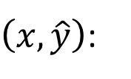

CRF v.s. HMM
CRF: increase $P\left(x,\hat{y}\right)$, decrease $P\left(x,y^{′}\right)$
To obtain correct results …
HMM does not do that
CRF more likely to achieve that than HMM
$\left(x,\hat{y}\right)$:
$$P\left(x,\hat{y}\right)>P\left(x,y\right)$$
c
a
HMM:
CRF:
x_{i}=a
P(V|N)=9/10
N
V
P
V
P(x_{i}|y_{i})
X 9
X 9
P(D|N)=1/10
a
y_{i-1}=N
y_{i}=?
P(a|V)=1/2
0.1
P(y_{i}|y_{i-1})
HMM:V
N
D
P(a|D)=1
CRF:D

Slide 8
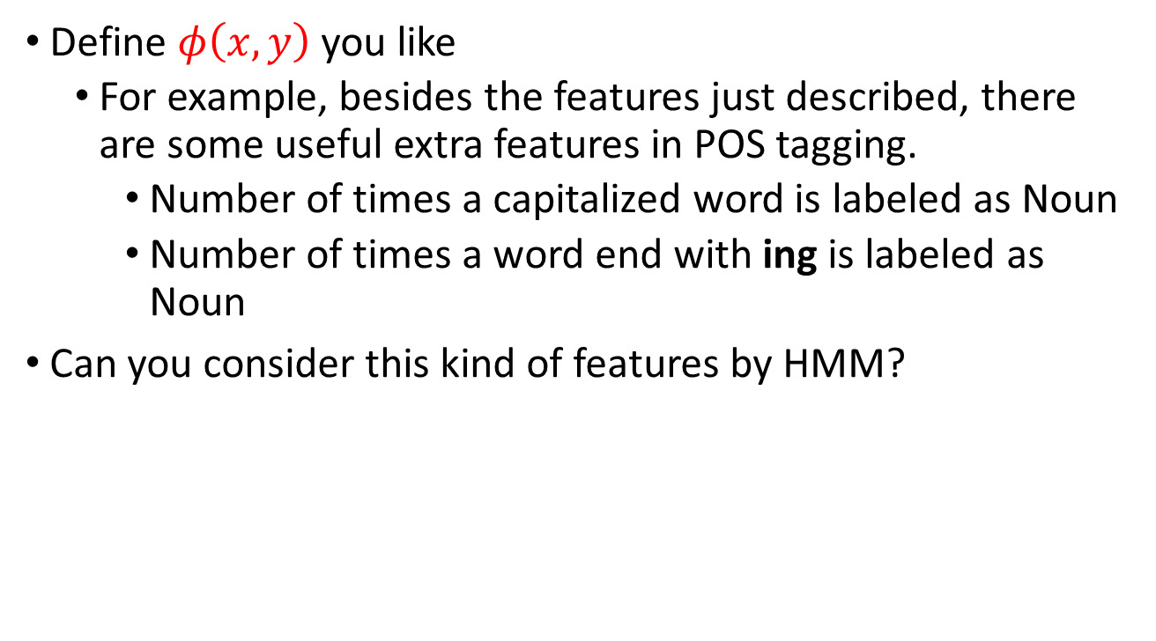
CRF v.s. HMM
Define $φ\left(x,y\right)$ you like
For example, besides the features just described, there are some useful extra features in POS tagging.
Number of times a capitalized word is labeled as Noun
Number of times a word end with ing is labeled as Noun
Can you consider this kind of features by HMM?
Too sparse…
$$P\left(x_{i}=A,x_{i} is capitalized,x_{i} end with \text{ing},…|y_{i}=N\right)$$
Method 1:
$P\left(x_{i}=A|y_{i}=N\right)P\left(x_{i} is capitalized|y_{i}=N\right)$……
Inaccurate assumption
Method 2. Give the distribution some assumptions?
Notes:
whether I should memtion HMM independen assumption here
But some feature may make inference difficult

Slide 9
Outline
Hidden Markov Model (HMM)
Conditional Random Field (CRF)
Structured SVM
Semi-Markov Models
Some Experiments
Structured Perceptron

Slide 10
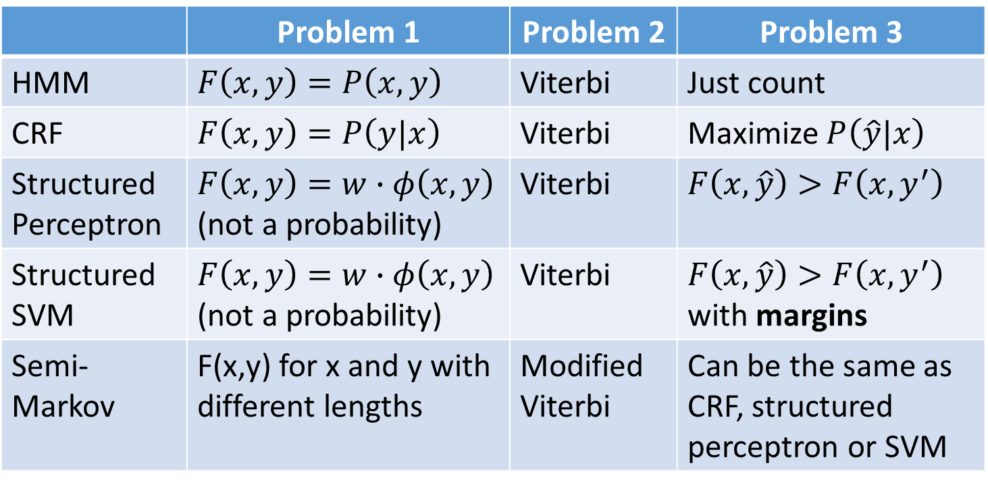
Concluding Remarks
Outlook:
RNN, LSTM, CTC
 | Problem 1 | Problem 2 | Problem 3
HMM | $$F\left(x,y\right)=P\left(x,y\right)$$ | Viterbi | Just count
CRF | $F\left(x,y\right)=P\left(y|x\right)$ | Viterbi | Maximize $P\left(\hat{y}|x\right)$
Structured Perceptron | $F\left(x,y\right)=w∙φ\left(x,y\right)$ (not a probability) | Viterbi | $$F\left(x,\hat{y}\right)>F\left(x,y^{′}\right)$$
Structured SVM | $F\left(x,y\right)=w∙φ\left(x,y\right)$ (not a probability) | Viterbi | $F\left(x,\hat{y}\right)>F\left(x,y^{′}\right)$ with margins
Semi-Markov | F(x,y) for x and y with different lengths | Modified Viterbi | Can be the same as CRF, structured perceptron or SVM
Notes:
CTC: http://citeseerx.ist.psu.edu/viewdoc/summary?doi=10.1.1.75.6306
Connectionist temporal classification: Labelling unsegmented sequence data with recurrent neural networks (2006)

Slide 11
Reference
Structured SVM
Tsochantaridis, Ioannis, et al. "Large margin methods for structured and interdependent output variables." Journal of Machine Learning Research. 2005.
http://machinelearning.wustl.edu/mlpapers/paper_files/TsochantaridisJHA05.pdf
Semi-Markov Model
Sarawagi, Sunita, and William W. Cohen. "Semi-markov conditional random fields for information extraction." Advances in Neural Information Processing Systems. 2004.
http://www.cs.cmu.edu/~wcohen/postscript/semiCRF.pdf

Slide 12
Appendix

Slide 13



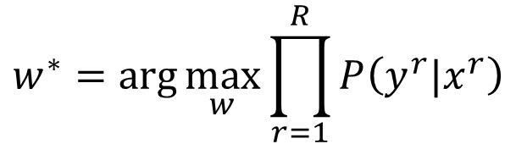

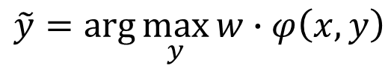
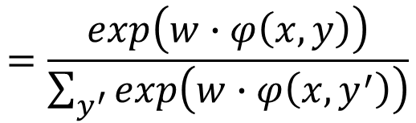


Structured SVM - Introduction
Structured Linear Model
CRF
Problem 1: Evaluation
Problem 2: Inference
Problem 3: Training
$$P\left(y|x\right)$$
$$=\frac{exp\left(w∙φ\left(x,y\right)\right)}{\sum_{y^{′}}{exp\left(w∙φ\left(x,y^{′}\right)\right)}}$$
$$F\left(x,y\right)=w∙φ\left(x,y\right)$$
$$\tilde{y}=arg\max_{y}{P\left(y|x\right)}$$
$$\tilde{y}=arg\max_{y}{w∙φ\left(x,y\right)}$$
$$=arg\max_{y}{w∙φ\left(x,y\right)}$$
$$∀r,∀y≠y^{r}$$
$$w^{∗}=arg\max_{w}{\prod_{r=1}^{R}{P\left(y^{r}|x^{r}\right)}}$$
$$F\left(x^{r},y^{r}\right)>F\left(x^{r},y\right)$$
Structured SVM modify this training criterion

Slide 14
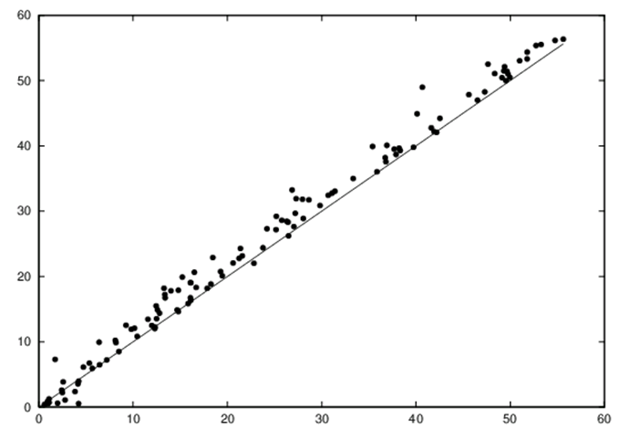
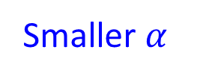
Synthetic Data: CMM v.s. CRF
CMM
Smaller $α$
CRF
CRF > CMM

Slide 15
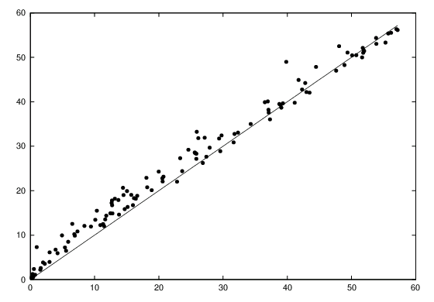
Synthetic Data: CMM v.s. HMM
1-st order HMM assumption is inaccurate
CMM
Smaller $α$
HMM
HMM>CMM (Data generate by HMM)

Slide 16
POS Tagging
Each word to be labeled with one of 45 tags.
out-of-vocabulary (OOV) words: not observed in the training set
When w_{o} is a OOV word, it is hard to estimate P(x_{i}=w_{o}|y_{i})
 | Error | OOV Error
HMM | 5.7% | 46.0%
CMM | 6.4% | 54.6%
CRF | 5.6% | 48.1%
CMM+ | 4.8% | 27.0%
CRF+ | 4.3% | 23.8%
+: add more features
whether word is capitalized,
whether word ends in –ing, -ogy, -ed, -s, -ly …)

Slide 17
http://dl.acm.org/citation.cfm?id=1102373
Mappings to structured output spaces (strings, trees, partitions, etc.) are typically learned using extensions of classification algorithms to simple graphical structures (eg., linear chains) in which search and parameter estimation can be performed exactly. Unfortunately, in many complex problems, it is rare that exact search or parameter estimation is tractable. Instead of learning exact models and searching via heuristic means, we embrace this difficulty and treat the structured output problem in terms of approximate search. We present a framework for learning as search optimization, and two parameter updates with convergence the-orems and bounds. Empirical evidence shows that our integrated approach to learning and decoding can outperform exact models at smaller computational cost.

Slide 18
Inference in Conditional Random Fields and Hidden Markov Models is done using the Viterbi algorithm, an efficient dynamic programming algorithm. In many cases, general (non-local and non-sequential) constraints may exist over the output sequence, but cannot be incorporated and exploited in a natural way by this inference procedure. This paper proposes a novel inference procedure based on integer linear programming (ILP) and extends CRF models to naturally and efficiently support general constraint structures. For sequential constraints, this procedure reduces to simple linear programming as the inference process. Experimental evidence is supplied in the context of an important NLP problem, semantic role labeling.
http://dl.acm.org/citation.cfm?id=1102444

Slide 19
We present Searn, an algorithm for integrating search and learning to solve complex structured prediction problems such as those that occur in natural language, speech, computational biology, and vision. Searn is a meta-algorithm that transforms these complex problems into simple classification problems to which any binary classifier may be applied. Unlike current algorithms for structured learning that require decomposition of both the loss function and the feature functions over the predicted structure, Searn is able to learn prediction functions for any loss function and anyclass of features. Moreover, Searn comes with a strong, natural theoretical guarantee: good performance on the derived classification problems implies good performance on the structured prediction problem.
http://link.springer.com/article/10.1007/s10994-009-5106-x

Slide 20
For general graphs where we do not want the sub-modularity condition, we can also consider an approximation where we use an approximate decoding method, such as loopy belief propagation or a stochastic local search method [Hutter et al., 2005]). However, theoretical and empirical work in [Finley and Joachims, 2008] shows that using such under-generating decoding methods (which may return sub-optimal solutions to the decoding problem) have several disadvantages compared to so-called over-generating decoding methods. A typical example of an over-generating decoding method is a linear programming relaxation of an integer programming formulations of decoding, where in the relaxation the objective is optimized exactly over an expanded space [Kumar et al., 2007], hence yielding a fractional decoding that is a strict upper bound on the optimal decoding.

Slide 21
More for Structured SVM
Margin re-scale v.s. slack rescale
One slack
Cutting plane -> bundle
Ref:
http://www.machinelearning.org/proceedings/icml2007/papers/206.pdf
http://courses.ischool.berkeley.edu/i290-dm/s11/SECURE/gidofalvi.pdf
http://www.cs.cmu.edu/afs/cs/user/aberger/www/html/tutorial/tutorial.html
http://www.cs.cornell.edu/people/tj/publications/joachims_etal_09a.pdf
http://www.cs.ubc.ca/~schmidtm/Documents/2009_Notes_StructuredSVMs.pdf
http://www.robots.ox.ac.uk/~vedaldi/assets/svm-struct-matlab/tutorial/ssvm-tutorial-handout.pdf
Notes:
http://www.di.ens.fr/willow/events/cvml2010/materials/INRIA_summer_school_2010_Christoph.pdf

Slide 22
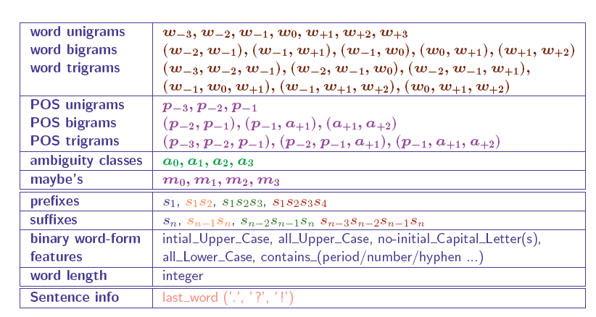
SVMs for tagging
from Jimenez & Marquez

Slide 23
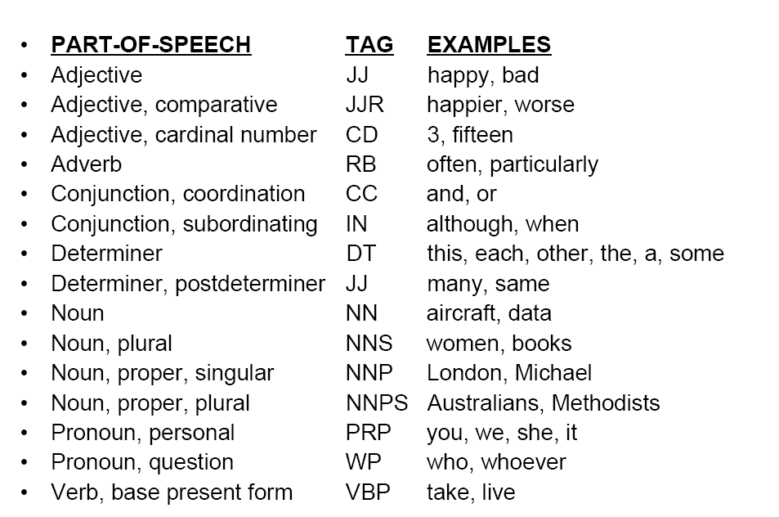
POS Tagging, examples from WSJ
From McCallum

Slide 25
Target Function
for all
What do we want to minimize?
perfect
bad
What is the minimum possible value of C(w)?
Notes:
Minimum value is 0

Slide 26
Appendix: Viterbi

Slide 27
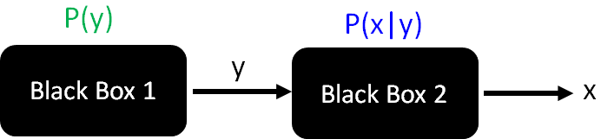
HMM - Problem 1
0.05
[Slides from Raymond J. Mooney]
0.1
Det
Noun
0.95
0.5
0.9
stop
0.05
Verb
0.25
0.1
PropNoun
0.8
0.4
0.5
0.1
0.25
0.1
start
P(y = “PropNoun Verb Det Noun”) = 0.4*0.8*0.25*0.95*0.1

Slide 28
HMM - Problem 1
[Slides from Raymond J. Mooney]
y = “PropNoun Verb Det Noun”
P(y) = 0.4*0.8*0.25*0.95*0.1
Tom
bit
the
cat
John
ate
saw
a
the
dog
Mary
played
a
the
saw
bed
Alice
the
a
apple
Jerry
hit
gave
that
pen
PropNoun
Verb
Det
Noun
John
saw
the
saw
P(John|PropNoun)
= 1/5

Slide 29
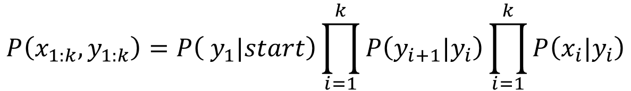
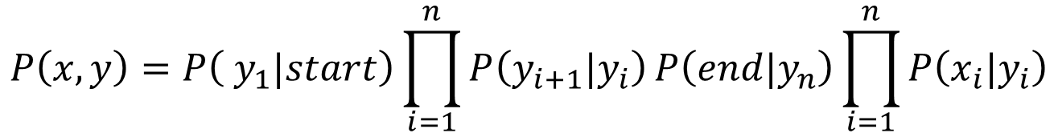
HMM - Problem 2: Viterbi Algorithm
$$P\left(x,y\right)=P\left( y_{1}|start\right)\prod_{i=1}^{n}{P\left(y_{i+1}|y_{i}\right)}P\left(end|y_{n}\right)\prod_{i=1}^{n}{P\left(x_{i}|y_{i}\right)}$$
$$P\left(x_{1:k},y_{1:k}\right)=P\left( y_{1}|start\right)\prod_{i=1}^{k}{P\left(y_{i+1}|y_{i}\right)}\prod_{i=1}^{k}{P\left(x_{i}|y_{i}\right)}$$
$$π\left(y_{n}=s\right)=\max_{y_{1:n−1}}{P\left(x_{1:n},y_{1:n−1},y_{n}=s\right)}$$
$$y_{1:n−1}^{∗}=arg\max_{y_{1:n}}{P\left(x_{1:n},y_{1:n−1},y_{n}=s\right)}$$

Slide 30










HMM: Problem 2 – Viterbi Algorithm
x_{k}
x_{k+1}
P
P
$$π\left(y_{k+1}=P\right)$$
$$π\left(y_{k}=P\right)$$
$$π\left(y_{k+1}=P\right)$$
$$=P\left(x_{k+1}|P\right)\max_{s}{P\left(P|s\right)π\left(y_{k+1}=P\right)}$$
V
V
$$π\left(y_{k}=V\right)$$
$$π\left(y_{k+1}=V\right)$$
D
D
$$π\left(y_{k}=D\right)$$
$$π\left(y_{k+1}=D\right)$$
N
N
$$π\left(y_{k}=N\right)$$
$$π\left(y_{k+1}=N\right)$$
……
……

Slide 31
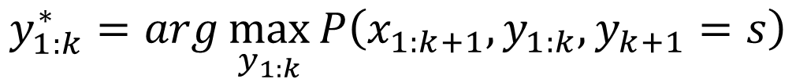
HMM: Problem 2 – Viterbi Algorithm
$$y_{1:k−1}^{∗}=arg\max_{y_{1:k−1}}{P\left(x_{1:k},y_{1:k−1},y_{k}=s\right)}$$
$$π\left(y_{k}=s\right)=\max_{y_{1:k−1}}{P\left(x_{1:k},y_{1:k−1},y_{k}=s\right)}$$
s is a possible tag
(e.g. N, V ……)
$$y_{1:k}^{∗}=arg\max_{y_{1:k}}{P\left(x_{1:k+1},y_{1:k},y_{k+1}=s\right)}$$
$$π\left(y_{k+1}=s\right)=\max_{y_{1:k}}{P\left(x_{1:k+1},y_{1:k},y_{k+1}=s\right)}$$

Slide 32








HMM: Problem 2 – Viterbi Algorithm
x_{k-2}
x_{k-1}
x_{k}
x_{k+1}
P
P
P
P
$$π\left(y_{k}=P\right)$$
$$π\left(y_{k+1}=P\right)$$
V
V
V
V
$$π\left(y_{k}=V\right)$$
$$π\left(y_{k+1}=V\right)$$
D
D
D
D
$$π\left(y_{k}=D\right)$$
$$π\left(y_{k+1}=D\right)$$
N
N
N
N
$$π\left(y_{k}=N\right)$$
$$π\left(y_{k+1}=N\right)$$

Slide 33
HMM: Problem 2 – Viterbi Algorithm
x_{k-2}
x_{k-1}
x_{k}
x_{k+1}
P
P
P
P
$$π\left(y_{k}=P\right)$$
$$π\left(y_{k+1}=P\right)$$
V
V
V
V
$$π\left(y_{k}=V\right)$$
$$π\left(y_{k+1}=V\right)$$
D
D
D
D
$$π\left(y_{k}=D\right)$$
$$π\left(y_{k+1}=D\right)$$
N
N
N
N
$$π\left(y_{k}=N\right)$$
$$π\left(y_{k+1}=N\right)$$

Slide 34
HMM: Problem 2 – Viterbi Algorithm
x:
John saw the saw.
P
P
P
P
V
V
V
V
Start
End
D
D
D
D
Start from the beginning
N
N
N
N

